Slide 1

Correlation Between High School Rank and House Value
Xingjia Wu
IS607 Final Project

Slide 2
Background
Factors that influence house value:
Location
School district
Security of neighborhoods
Travel levels
Other factors:
Size and condition
local economy

Slide 3
Hypothesis
The average prices of nearby houses are higher when the high schools get better ranking.
School Ranking
House Value

Slide 4
Data
High School Rank
House Value
Geographical Coordinates
(latitude and longitude)

Slide 5

Data Source (1)
High School Rank
http://www.usnews.com/education/best-high-schools/national-rankings

Slide 6
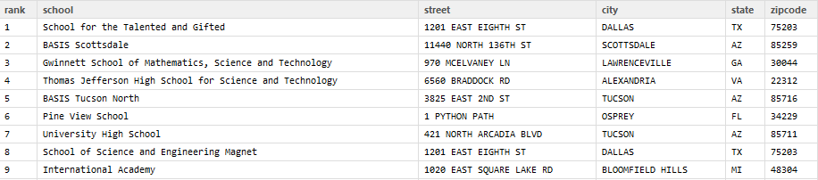
Data Source (1)
Tool: rvest package

Slide 7
Data Source (2)
House Value
Tool: XML package
zipcode
Zillow GetDemographics API
Zillow Home Value Index
(median home valuation)

Slide 8
Data Source (3)
Geographical Coordinates
Tool: ggmap package, geocode()
> geocode('23112')
Information from URL : http://maps.googleapis.com/maps/api/geocode/json?address=23112&sensor=false
Google Maps API Terms of Service : http://developers.google.com/maps/terms
lon lat
1 -77.66507 37.44701

Slide 9
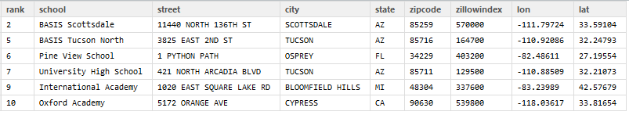
Data Transformation and Cleanup
‘rank’ from character to integer
‘zipcode’ from factor into character
‘zillowIndex’ from factor into numeric
Filter data that contain NULL in zillowIndex, school rank.
Further filter the states that have less than 2 schools (TX and DE)

Slide 10
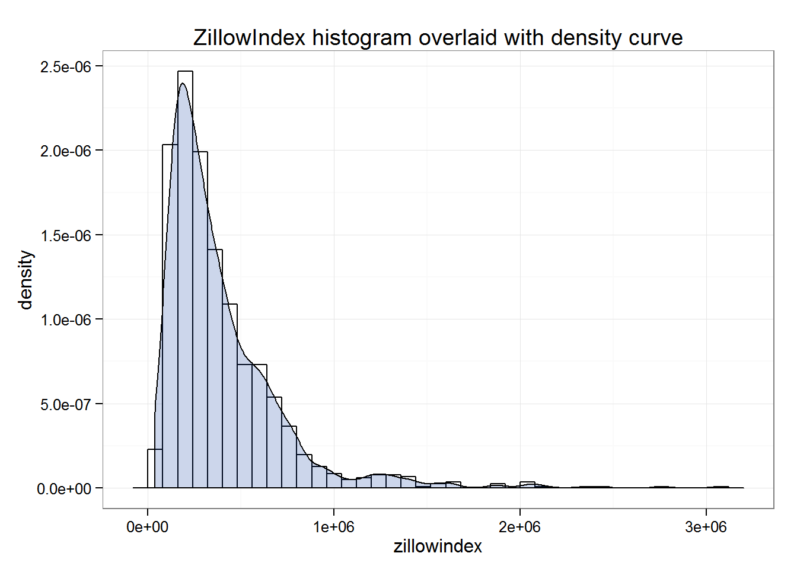
Descriptive Statistics
Total records: 1469
Total states included in the data: 34 states
ZillowIndex: range from 35,700 to 3,068,900
Notes:
http://www.tc3.edu/instruct/sbrown/stat/shape.htm
Highly right skewed (skewness = 2.72)
(Kurtosis = 11.9)

Slide 11
Data Analysis

Slide 12
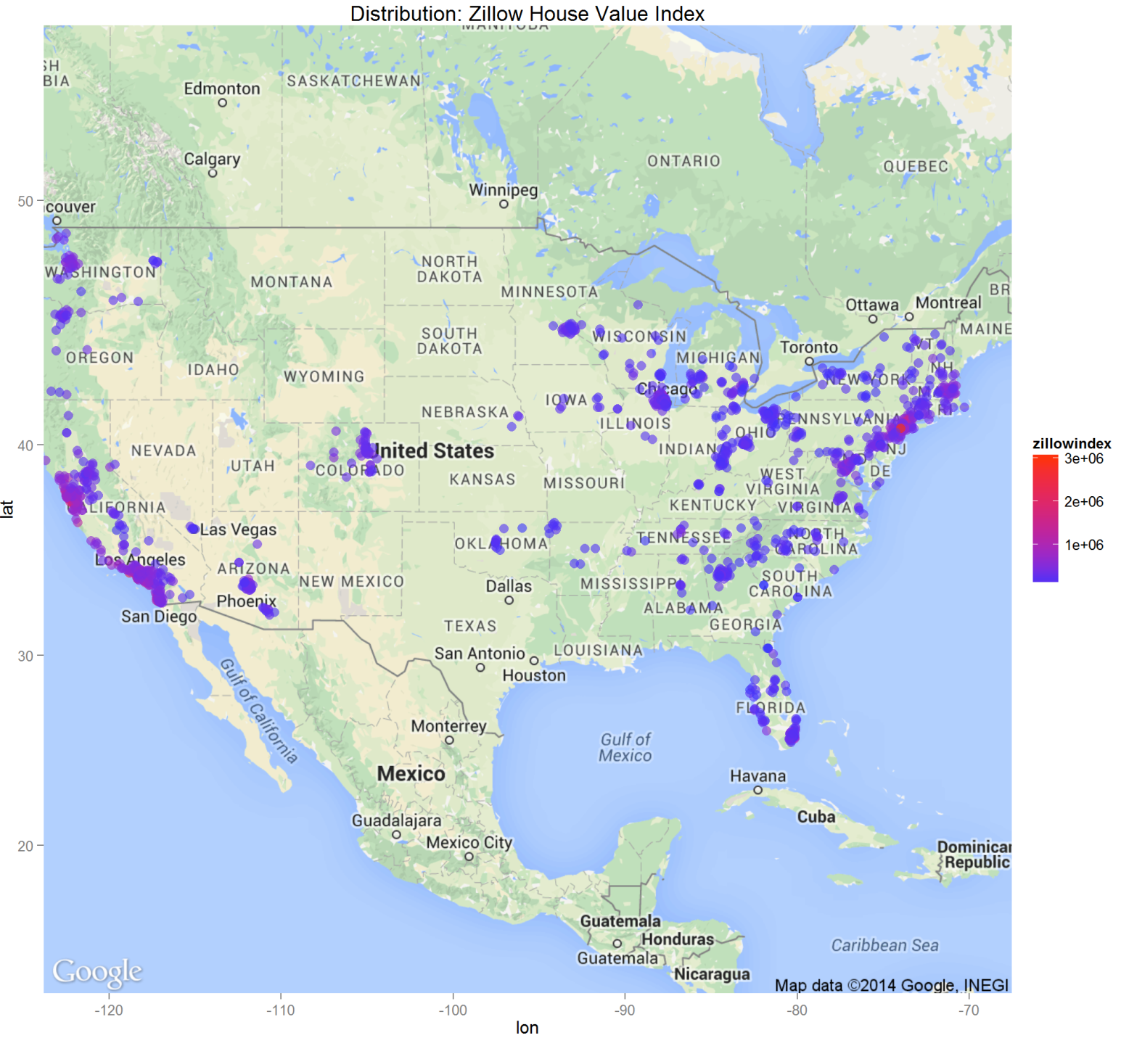
Geographical distribution – House Value
Notes:
Expensive houses are located at west coast and northeast coast.

Slide 13
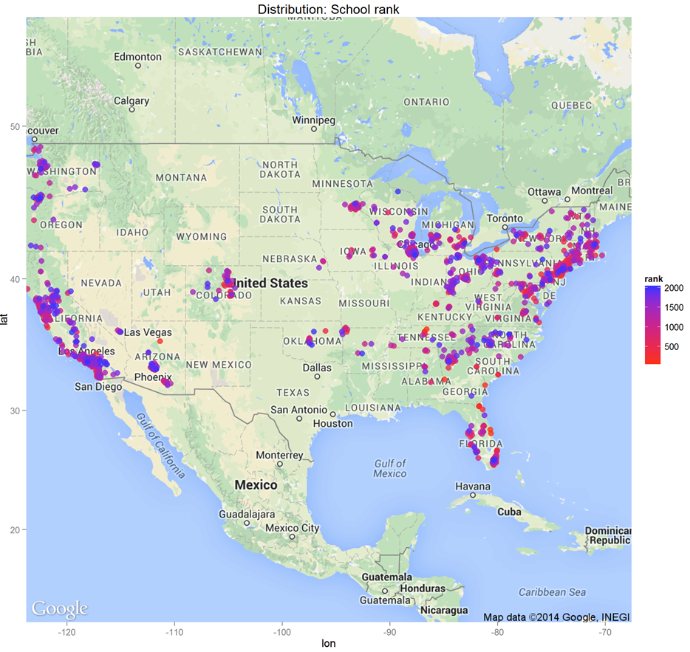
Geographical distribution – School Rank
Notes:
Schools with different ranks are more evenly distributed.

Slide 14
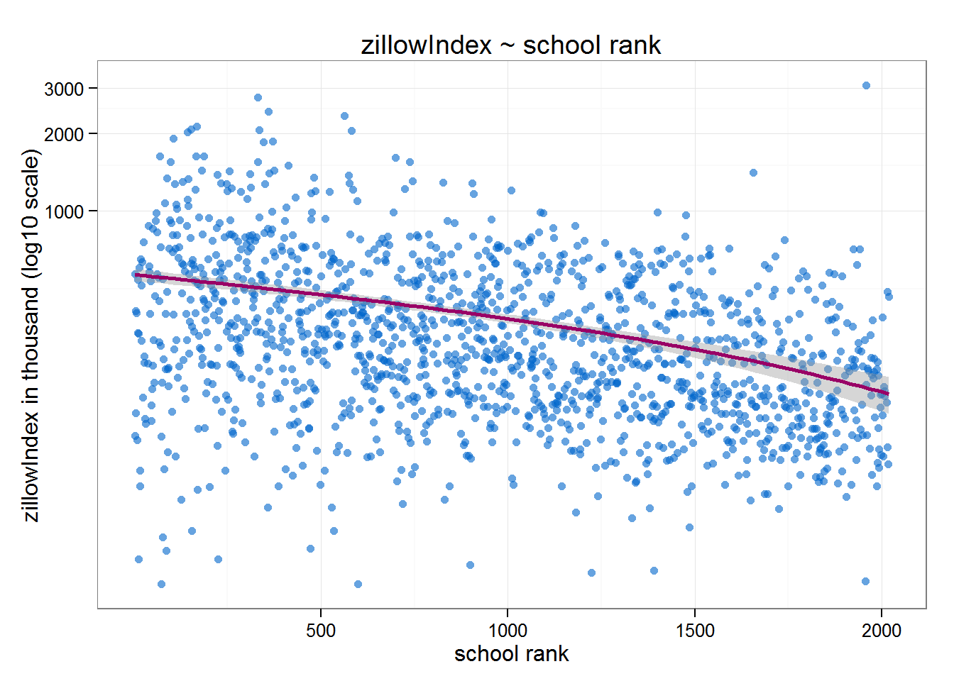
Data Analysis
Plot of zillowIndex and school rank
Correlation: -0.3305684
weak downhill (negative) linear relationship

Slide 15
Correlation by state
school %>%
group_by(state) %>%
summarize(count= n(), cor = cor(rank, zillowindex)) %>%
arrange(cor)
 | state | count | cor |  |  | state | count | cor
1 | NE | 3 | -0.911 |  | 18 | IL | 70 | -0.421
2 | VT | 7 | -0.886 |  | 19 | GA | 47 | -0.407
3 | AR | 11 | -0.809 |  | 20 | NJ | 36 | -0.384
4 | HI | 4 | -0.695 |  | 21 | CT | 37 | -0.349
5 | NC | 32 | -0.672 |  | 22 | NV | 7 | -0.260
6 | AL | 9 | -0.617 |  | 23 | NY | 110 | -0.244
7 | OR | 23 | -0.588 |  | 24 | CO | 40 | -0.226
8 | MD | 41 | -0.588 |  | 25 | NH | 13 | -0.208
9 | MN | 26 | -0.582 |  | 26 | FL | 80 | -0.124
10 | VA | 35 | -0.572 |  | 27 | AZ | 42 | -0.098
11 | WA | 47 | -0.569 |  | 28 | SC | 11 | -0.078
12 | CA | 399 | -0.510 |  | 29 | RI | 5 | -0.069
13 | TN | 16 | -0.477 |  | 30 | WI | 25 | -0.044
14 | MI | 46 | -0.457 |  | 31 | WV | 5 | 0.033
15 | MA | 60 | -0.453 |  | 32 | KY | 10 | 0.112
16 | PA | 47 | -0.442 |  | 33 | OK | 11 | 0.358
17 | OH | 105 | -0.430 |  | 34 | IA | 9 | 0.375
Notes:
Right skewed

Slide 16
Conclusion
Weak coorrelation between rank of school and average house value
High differences of cor between states.
School Ranking
cor = -0.33
House Value

Slide 17
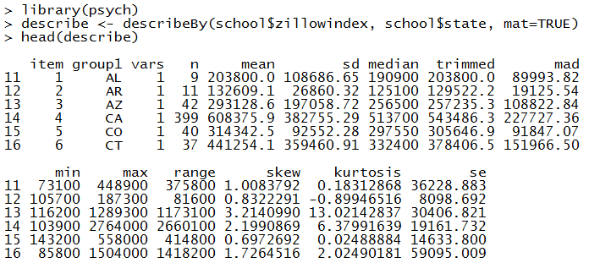
New Features
ggmap
psych: describe(), describeBy()
Notes:
summary statistics
Skewness and Kurtosis

Slide 18
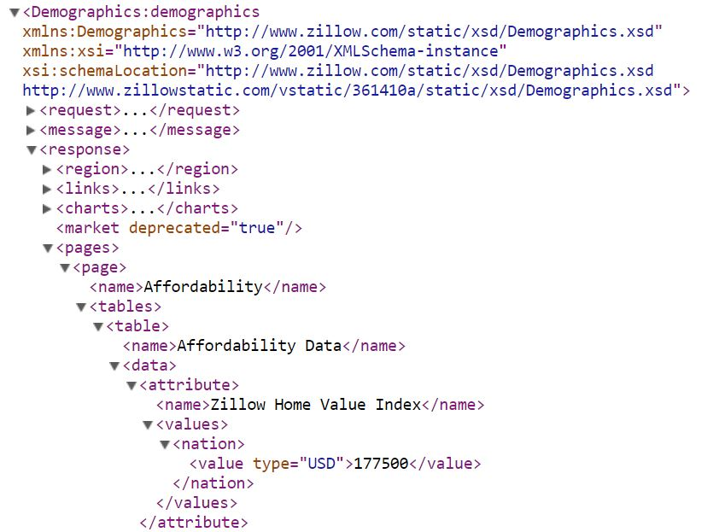
Challenges
Zillow API only allows 1000 queries per day
Parse XML

Slide 19
Challenges
XML package: Xpath query
> library(XML)
> web <- 'http://www.zillow.com/webservice/GetDemographics.htm?zws-id='
> zwsid <- 'X1-ZWz1dx93rz7eob_9fxlx'
> zip <- '23112'
> url <- paste0(web, zwsid, '&zip=', zip)
xmlTreeParse
> zillow1 <- xmlTreeParse(url)
> root <- xmlRoot(zillow1)
> page <- root[[3]][[5]][[1]][[2]][[1]][[2]][[1]][[2]][[1]][[1]]
> xmlValue(page)
[1] "221700"
xmlParse
> zillow2 <- xmlParse(url)
> path <- "//response/pages//attribute/name[contains(text(), 'Zillow Home Value Index')]/..//zip/value"
> xpathSApply(zillow2, path = path, xmlValue)
[1] "221700"
Notes:
http://stackoverflow.com/questions/20684507/in-r-xml-package-what-is-the-difference-between-xmlparse-and-xmltreeparse
http://www.inside-r.org/packages/cran/XML/docs/htmlTreeParse
xmlParse is equivalent to the xmlTreeParse except it uses a default value for the useInternalNodes parameter of TRUE. xmlParse returns internal nodes/C-level nodes, which can be searched XPath expressions
xmlTreeParse generates an R structure representing the XML/HTML tree. Navigate from the root xmlParse

Slide 20
Thank you!

Slide 22
